Slide 1


Slide 2

CRUD Operations
Create:
Adding new documents to the collection.
Read:
Retrieving documents from collection.
Update:
Updating documents in collection.
Delete:
Removing documents from collection.

Slide 3
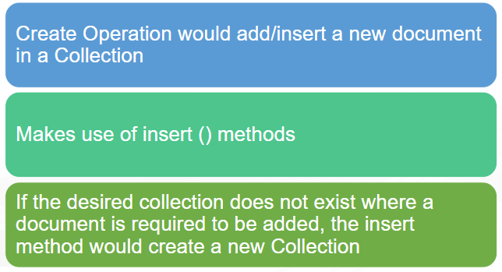
Create Operation

Slide 4
Insert operations
Insert can be used to insert single or multiple documents.
Each document stored in a collection required a unique _id field that act as primary key.
Example: db.users.insert({“name”: “abc”})
db.users.insert({“name”: “abc”, “email”: “abc@gmail.com”})
Insert can also be used to insert multiple documents.
db.users.insert([{“name”: “abc”, “email”: “abc@gmail.com”}, {“name”: “xyz”, “email”: “xyz@gmail.com”}, ……. ])

Slide 5
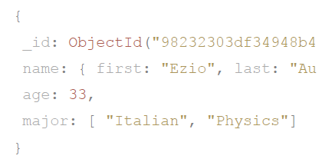
The _id Field
The _id field is assigned to each document as a unique identifier.
By default when inserting a new document into a collection, if you don’t specify an _id field, then MongoDB will automatically generate a unique Object Id and assign it as the value for that document’s _id field.

Slide 6
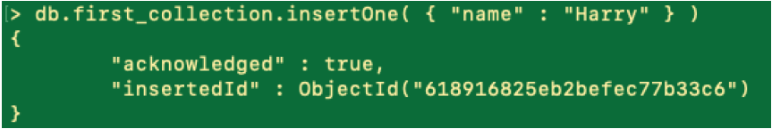
Create Operation: .insertOne()
The .insertOne() method inserts a document into a collection. It requires a single parameter, the document to be inserted.
Adds a single document in the collection.
Syntax: db.<collection_name>.insertOne({“field”: “value”})

Slide 7
Create Operation: .insertMany()
The .insertMany() method inserts multiple documents into a collection.
An array of multiple documents is passed through insertMany() method.
Syntax: db.first_collection.insertMany([{“field”: “value”}])
If the specified collection does not exist, it will create the collection and insert the given documents upon successful execution of the command.
Both insertOne() and insertMany() would return newly inserted documents with _id field.

Slide 8
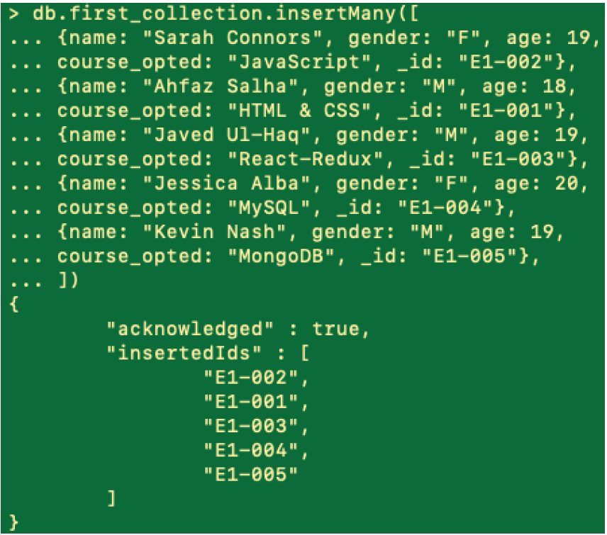

Slide 9
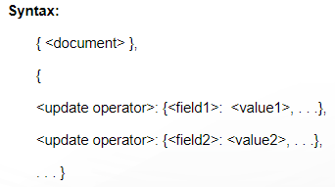
Update operations
Modify created documents in the collection.
These operations update a single collection at a time.
Criteria or filters can be specified identifying the documents that are to be updated.
MongoDB offers the following methods for updating documents:
updateOne()
updateMany()
replaceOne()
To update the entire collection with a field value, pass an empty filter {} in place of {<document>}

Slide 10
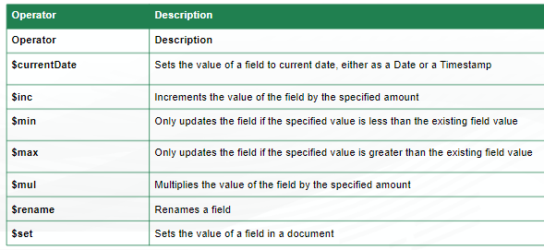
Update operators
To update a document, MongoDB has many in-built update operators. These operators are to be used for passing the updated form of the document to the update methods.

Slide 11
updateOne() and updateMany()
The .updateOne() method updates a single document that satisfies a given filter.
db.users.updateOne( { name: “Bob"}, { $set: { course: “CSE"}, $currentDate: {lastModified:true } })
The .updateMany() method updates all documents that satisfy a specific filter criteria.
db.employees.updateMany({ salary: 70000 }, { $set: { salary: 85000 }})

Slide 12
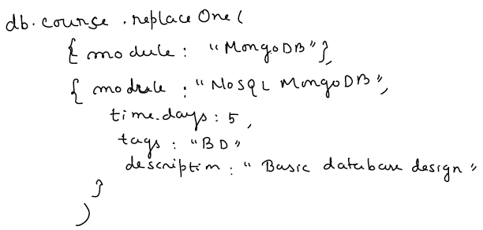
replaceOne()
The .replaceOne() method replaces a single document within the collection based on filter criteria.
Will replace the first whole document which contains the specified field value.
We cannot change the _id value using replaceOne()

Slide 13
Delete Operation
Removes the specified documents from the collection.
These operations delete documents in a single collection at a time.
The deleteOne() method removes a single document from a collection. It has a single required parameter which is a filter criteria to match a specific document to delete.
db.courses.deleteOne({module: “java”})
The .deleteMany() method removes all documents that match a given filter criteria. It takes in a single required parameter, the filter criteria to match multiple documents.
db.courses.deleteMany({module: “java”})

Slide 14
Read/Query Operations
Read through documents and retrieve the specified document(s) from a Collection by querying the collection for documents.
MongoDB provides find() method to read and retrieve documents from collection.
Syntax: db.<collection_name>.find({field: “value”})
Query filters could also be specified to retrieve multiple documents from a large Collection using a single or multiple filters.
The db.collection.findOne() method also performs a read operation to return a single document.

Slide 15
Select All Documents in a Collection: An empty query document ({}) selects all documents in the collection: db.inventory.find( {} )
Not specifying a query document to the find() is equivalent to specifying an empty query document. db.inventory.find()
Specify Equality Condition:
To specify equality condition, use the query document { <field>: <value> } to select all documents that contain the <field> with the specified <value>.
db.inventory.find( { type: "snacks" } )

Slide 16
Specify Conditions Using Query Operators
A query to retrieve a specific document can be created using many operators provided by MongoDB.
For example: using the operator $in, can retrieves all documents in the particular Collection where the field equals the specified value or either of the multiple specified values.
By default, when only one value is specified and we do not indicate the operator, MongoDB uses the operator $in.
For example:
db.<collection_name>.find({field: {$in: “value”}}) is equivalent to db.<collection_name>.find({field: “value”})
Syntax for querying documents having values equal to either of the specified multiple value:
db.<collection_name>.find({field: {$in: [“value1”, “value2”]}})
db.courses.find({module: { $in: [“JavaScript”, “MongoDB”]}})

Slide 17
SQL to MongoDB Mapping

Slide 18
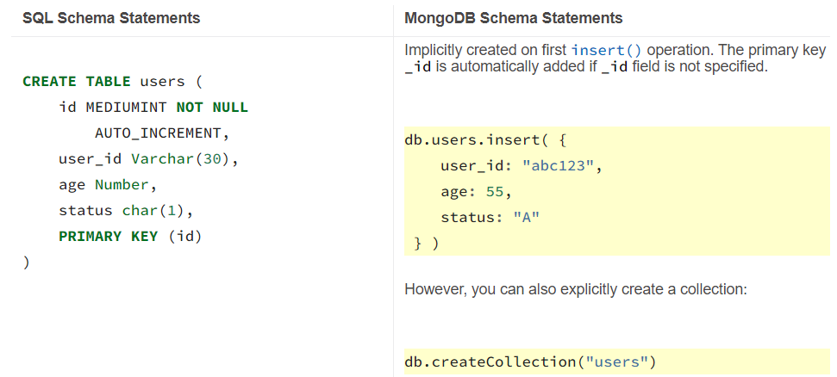
Create and drop operation

Slide 19
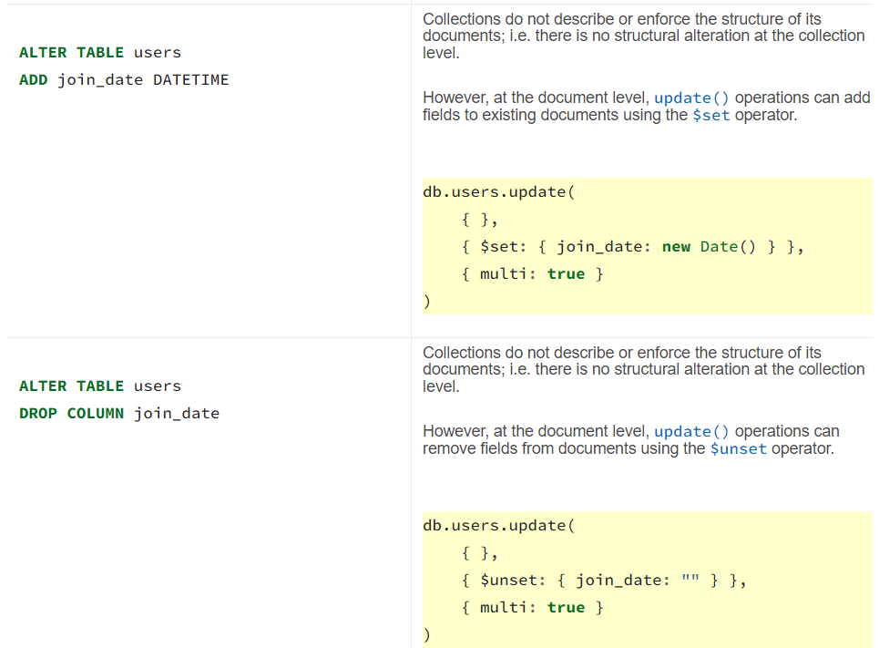
Alter Operation

Slide 20
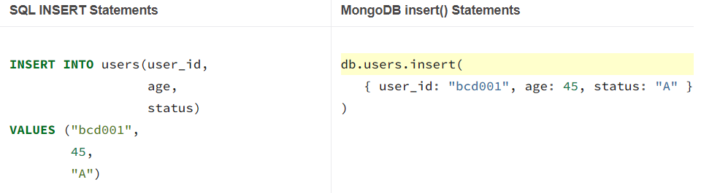
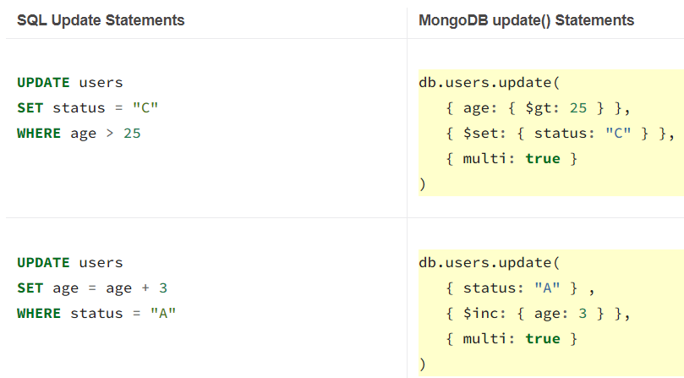
Insert and update operation

Slide 21
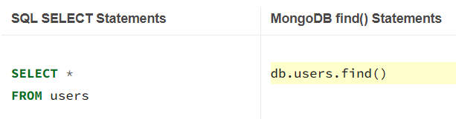
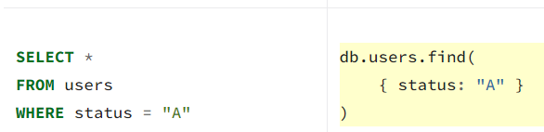
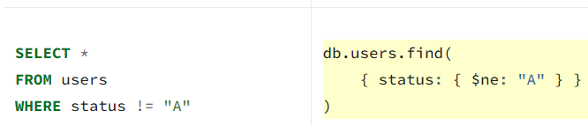
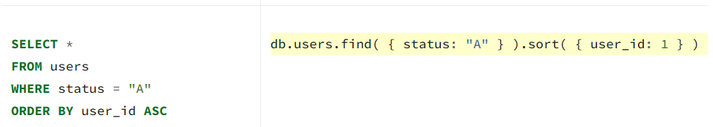
Select operation

Slide 22
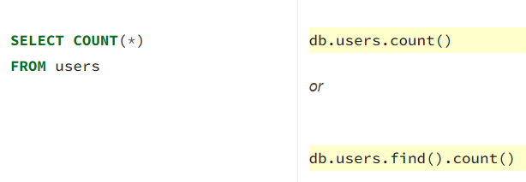
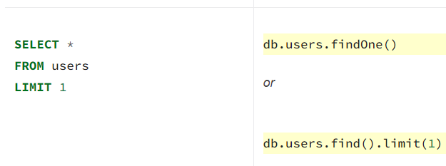

Slide 23
Drop: db.collection.drop()Removes a collection from the database. The method also removes any indexes associated with the dropped collection.
It takes no arguments and will produce an error if called with any arguments. Returns: true, when successfully drops a collection and false when collection to drop does not exist.
To remove all documents from a collection, it may be more efficient to use the drop() method to drop the entire collection, including the indexes and then recreate the collection and rebuild the indexes.
Delete:
To delete multiple documents, use db.collection.deleteMany().
To delete a single document, use db.collection.deleteOne().
$unset: The $unset operator deletes a particular field. The specified value in the $unset expression (i.e. "") does not impact the operation. If the field does not exist, then $unset has no effect.
db.products.update( { sku: "unknown" },{ $unset: { quantity: “ ”, instock: “ ” }})

Slide 25
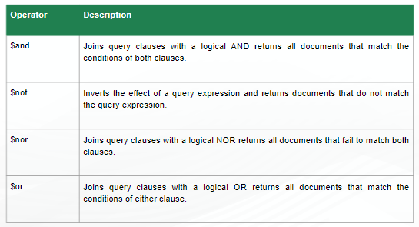
Logical Query Operators
Logical operators return data based on expressions that evaluate to true or false.

Slide 26
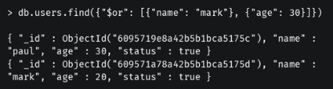
$and operator: Returns all documents match the conditions of both clauses.
Syntax: db.<collection_name>.find({$and: [{field1: “value1”}, {field2: “value2”}]})
Example: db.courses.find({$and: [{“course_name”: “Java”},{“marks”:60}]})
$or operator: Returns all documents that match either of the given conditions.
Syntax: db.<collection_name>.find({$or: [{field1: “value1”}, {field2: “value2”}]})

Slide 27
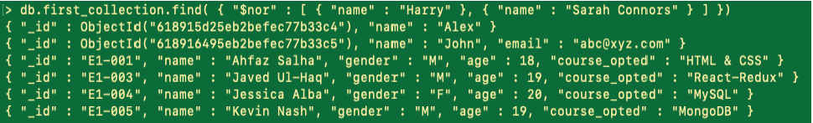
$not operator: Inverts the effect of a query expression and returns documents that do not match the query expression.
Example: db.course.find({“name”: {$not: {$eq: “Mark”}}})
$nor operator: Returns document which do not match with neither of the given condition.

Slide 28
Comparison Query Operator
Comparison operators return data based on value comparisons.
$eq: Specifies equality condition. The $eq operator matches documents where the value of a field equals the specified value.
Syntax: { <field>: { $eq: <value> } }
Example: db.trips.find({tripduration:{$eq:800}})
$gt: selects those documents where the value of the specified field is greater than (i.e. >) the specified value.
Syntax: { field: { $gt: value } }
Example: db.trips.find({tripduration:{$gt:800}})

Slide 29
$lt: selects the documents where the value of the field is less than (i.e. <) the specified value.
Syntax: { field: { $lt: value } }
Example: db.trips.find({tripduration:{$lt:800}})
$gte: selects the documents where the value of the specified field is greater than or equal to (i.e. >=) a specified value (e.g. value.)
Syntax: { field: { $gte: value } }
Example: db.trips.find({"birth year":{$gte:1980}})
$lte: selects the documents where the value of the field is less than or equal to (i.e. <=) the specified value.
Syntax: { field: { $lte: value } }
Example: db.trips.find({tripduration:{$lte:800}})

Slide 30
$in: The $in operator selects the documents where the value of a field equals any value in the specified array.
Syntax: { field: { $in: [<value1>, <value2>, ... <valueN> ] } }
Example: db.trips.find({ "start station name": { $in: ["Howard St & Centre St", "10 Ave & W 28 St"] } })
$ne: selects the documents where the value of the specified field is not equal to the specified value.
Syntax: { field: { $ne: value } }
Example: db.trips.find({tripduration:{$ne:800}})
$nin: selects the documents where: the specified field value is not in the specified array or the specified field does not exist.
Syntax: { field: { $nin: [ <value1>, <value2> ... <valueN> ] } }
Example: db.trips.find({ "start station name": { $nin: ["Howard St & Centre St", "10 Ave & W 28 St"] } })

Slide 31
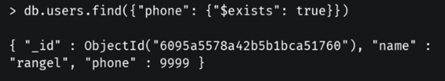
Element Query Operators
Element operators return data based on field existence or data types.
$exists: The $exists operator matches documents that contain or do not contain a specified field, including documents where the field value is null.
Syntax: { field: { $exists: <boolean> } }
When <boolean> is true, $exists matches the documents that contain the field, including documents where the field value is null.
If <boolean> is false, the query returns only the documents that do not contain the field.
Example: Find all the users where the phone field exists.
MongoDB $exists does not correspond to SQL operator exists. For SQL exists, refer to the $in operator.

Slide 32
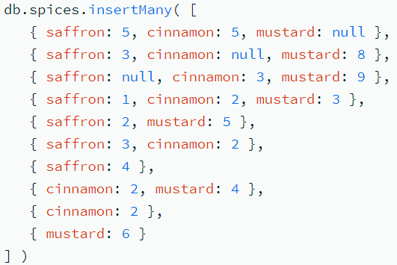
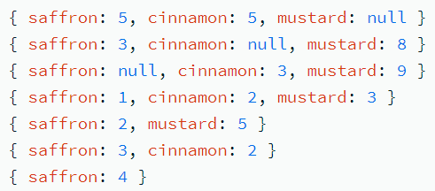
Exists and Not Equal To
This query will select all documents in the inventory collection where the qty field exists and its value does not equal 5 or 15.
Null Values: $exists: true
Output:

Slide 33
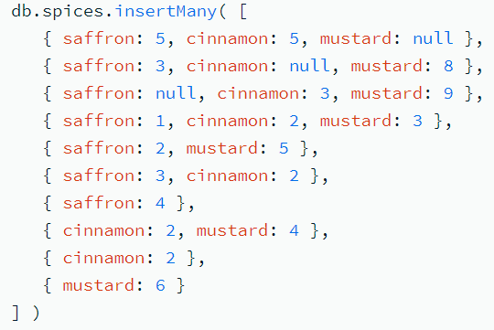

$exists: false
Query:
Output:

Slide 34

$type: Selects documents if a field is of the specified type.
$type selects documents where the value of the field is an instance of the specified BSON type(s).
Querying by data type is useful when dealing with highly unstructured data where data types are not predictable.
Syntax: { field: { $type: <BSON type> } }
BSON type can be specified either by number or name.
Example1: Find all the users where the phone field type is true.
Example 2: db.companies.find({description:{$type:2}})

Slide 35
The $type expression can also accept an array of BSON types as:
{ field: { $type: [ <BSON type1> , <BSON type2>, ... ] } }
The above query will match documents where the field value is any of the listed types.
For documents where field is an array, $type returns documents in which at least one array element matches a type passed to $type.
Queries for $type: "array" return documents where the field itself is an array.

Slide 36
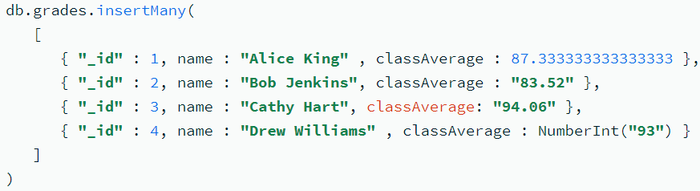

queries return all documents where classAverage is the BSON type string or double or is an array containing an element of the specified types.

Slide 37
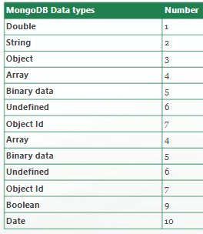
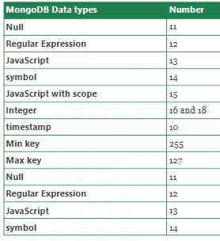
MongoDB Data Types

Slide 38
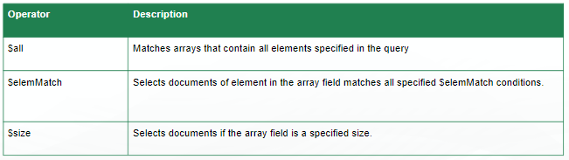
Array Query Operators
Array operators return data based on array conditions.

Slide 39
$all operator
The $all operator selects the documents where the value of a field is an array that contains all the specified elements.
Syntax: { <field>: { $all: [ <value1> , <value2> ... ] } }
Behavior: Equivalent to $and Operation
The $all is equivalent to an $and operation of the specified values; i.e. the following statement:
{ tags: { $all: [ "ssl" , "security" ] } } is equivalent to: { $and: [ { tags: "ssl" }, { tags: "security" } ] }

Slide 40

Find all documents in which tag field array contains “b” and “c”

Slide 41
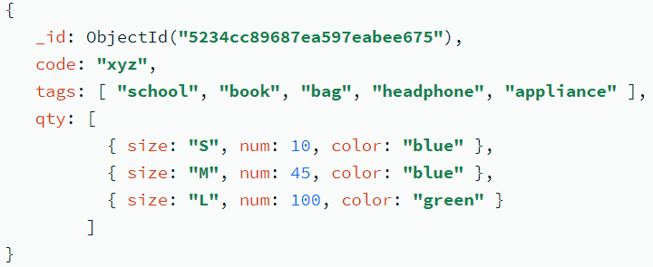
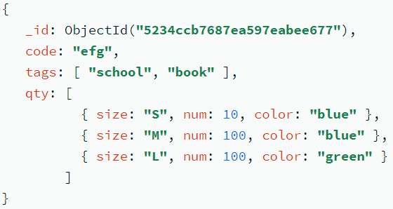
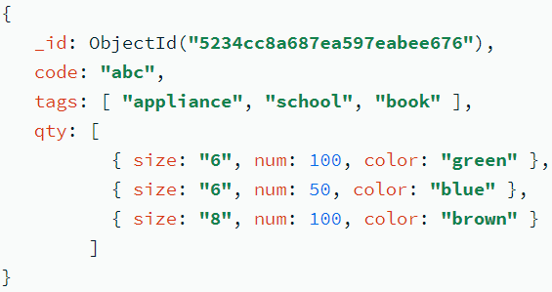
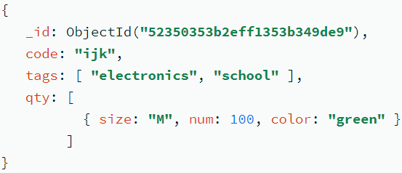
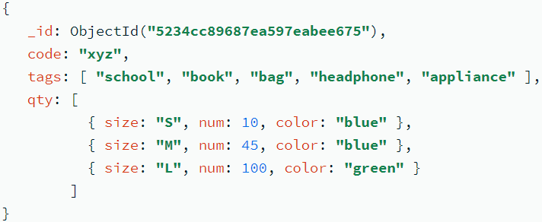

Query:
Output:

Slide 42

$elemMatch Operator
The $elemMatch operator matches documents that contain an array field with at least one element that matches all the specified query criteria.
Syntax: { <field>: { $elemMatch: { <query1>, <query2>, ... } } }
Find all documents where score >=50 and <90.

Slide 43

Documents in the scores collection:
{ _id: 1, results: [ 82, 85, 88 ] }, { _id: 2, results: [ 75, 88, 89 ] }
This query matches only those documents where the results array contains at least one element that is both greater than or equal to 80 and is less than 85.
The query returns the following document since the element 82 is both greater than or equal to 80 and is less than 85.

Slide 44
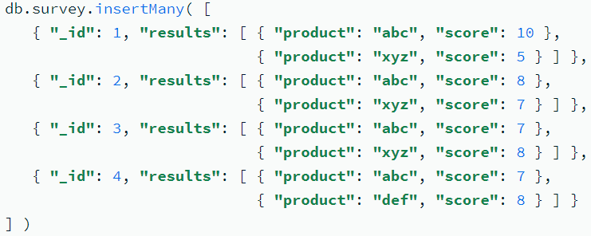

Array of Embedded Documents:
Query:
The query matches only those documents where the results array contains at least one element with both product equal to "xyz" and score greater than or equal to 8.
Output:

Slide 45




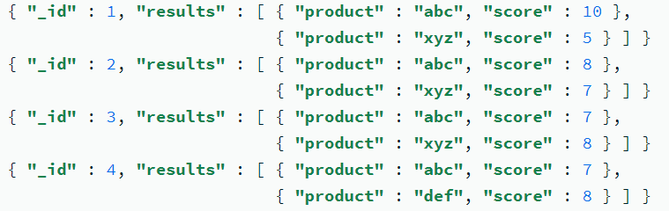
Single Query Condition: If specifying a single query predicate in the $elemMatch expression, and not using the $not or $ne operators inside of $elemMatch, $elemMatch can be omitted.
With $elemMatch:
Without $elemMatch:
However, if $elemMatch expression contains the $not or $ne operators then omitting the $elemMatch expression changes the documents returned.
With $elemMatch: Without $elemMatch:

Slide 46

$size Operator
The $size operator matches any array with the number of elements specified by the argument.
Find documents where tag field has 3 element.

Slide 47
Example: db.collection.find( { field: { $size: 2 } } );
This query returns all documents in collection where field is an array with 2 elements.
For instance, the above expression will return { field: [ red, green ] } and { field: [ apple, lime ] } but not { field: fruit } or { field: [ orange, lemon, grapefruit ] }.
To match fields with only one element within an array use $size with a value of 1, as follows:
db.collection.find( { field: { $size: 1 } } );
$size does not accept ranges of values.

